Slide 1
Discrete Mathematics and Its Application 7th edition, 2001
Kenneth H. Rosen

Slide 2
Welcome to Discrete Mathematics Spring 2018
Instructor: Niu Shao Zhang

Slide 3
§2.5 Cardinality of Sets
Section Summary
Cardinality(基数)
Countable Sets(可数集)
Computability(可计算性)

Slide 4
Cardinality
Definition: The cardinality of a set A is equal to the cardinality of a set B, denoted
|A| = |B|,
if and only if there is a one-to-one correspondence (i.e., a bijection) from A to B.
If there is a one-to-one function (i.e., an injection) from A to B, the cardinality of A is less than or the same as the cardinality of B and we write |A| ≤ |B|.
When |A| ≤ |B| and A and B have different cardinality, we say that the cardinality of A is less than the cardinality of B and write |A| < |B|.

Slide 5
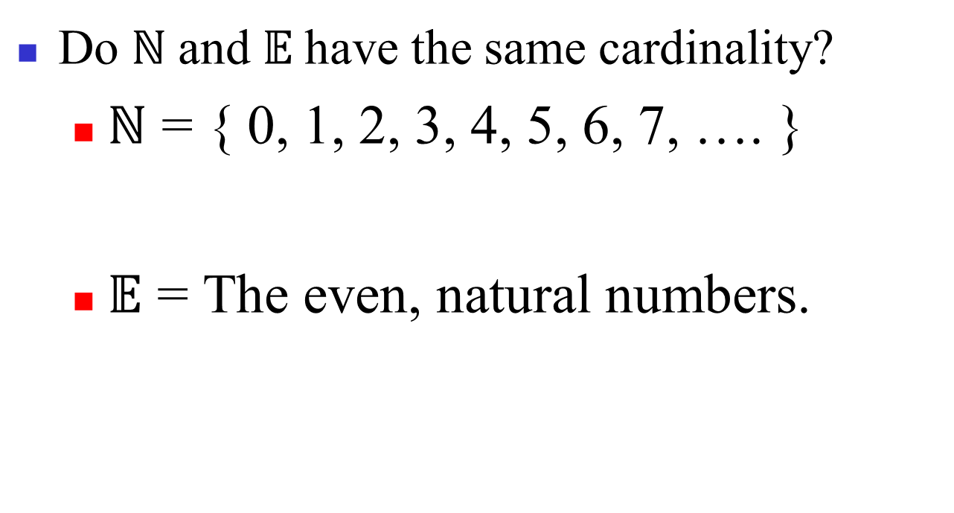
Same cardinality?

Slide 6
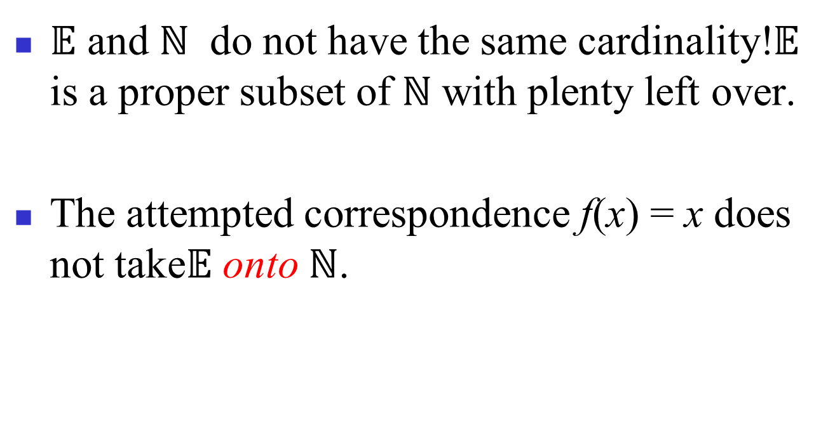
Same cardinality?

Slide 7
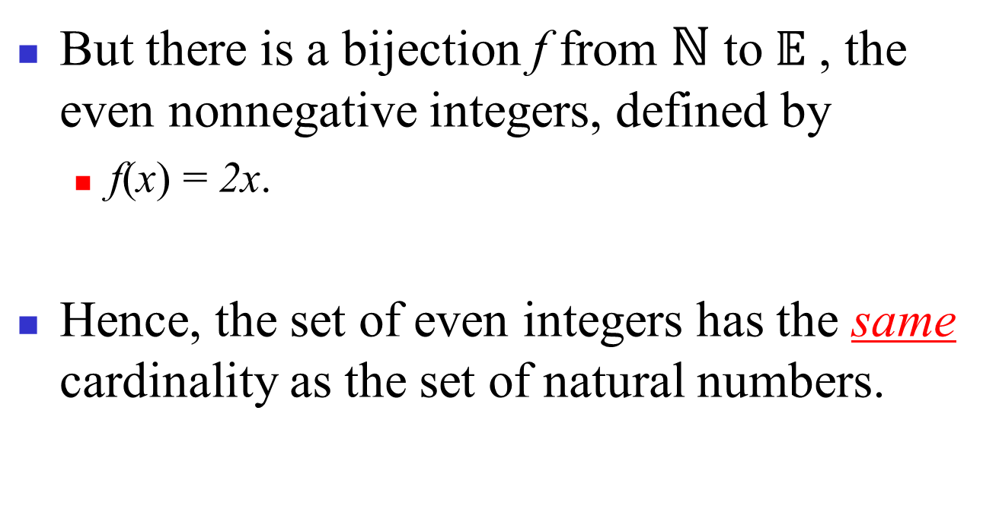
Same cardinality?

Slide 8
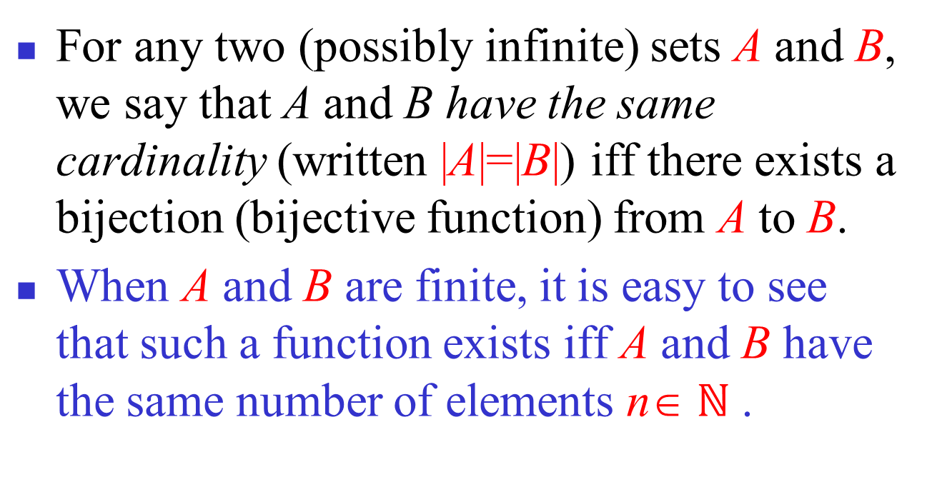
Cardinality: Formal Definition

Slide 9
Cardinality
Definition: A set that is either finite or has the same cardinality as the set of positive integers (Z⁺) is called countable. A set that is not countable is uncountable.
The set of real numbers R is an uncountable set.
When an infinite set is countable (countably infinite) its cardinality is ℵ₀ (where ℵ is aleph, the 1st letter of the Hebrew alphabet(希伯来字母)). We write |S| = ℵ₀ and say that S has cardinality “aleph null.”

Slide 10
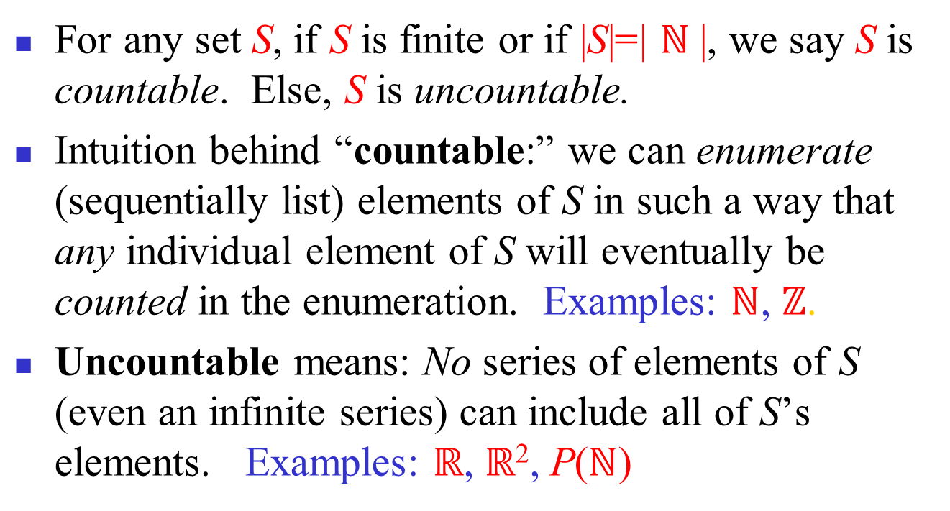
Countable versus Uncountable

Slide 11
Showing that a Set is Countable
An infinite set is countable if and only if it is possible to list the elements of the set in a sequence (indexed by the positive integers).
The reason for this is that a one-to-one correspondence f from the set of positive integers to a set S can be expressed in terms of a sequence a₁,a₂,…, a_{n} ,… where a₁ = f(1), a₂ = f(2),…, a_{n} = f(n),…

Slide 12
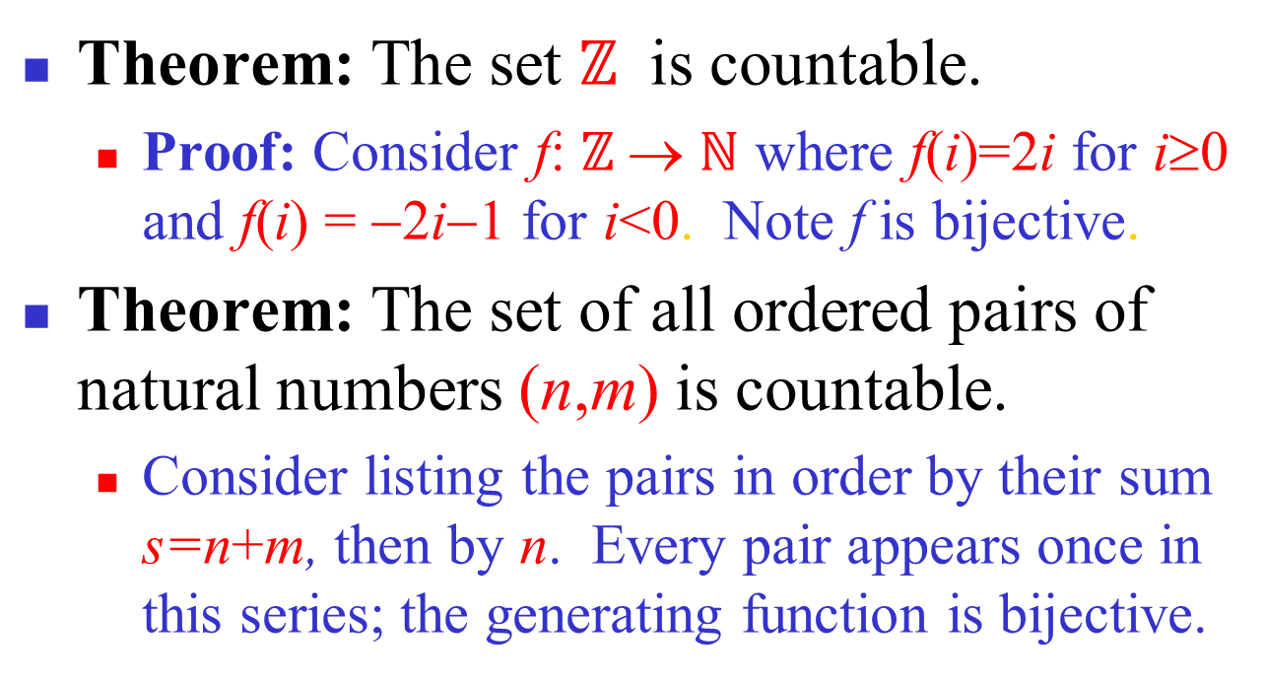
Countable Sets: Examples

Slide 13
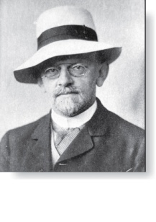
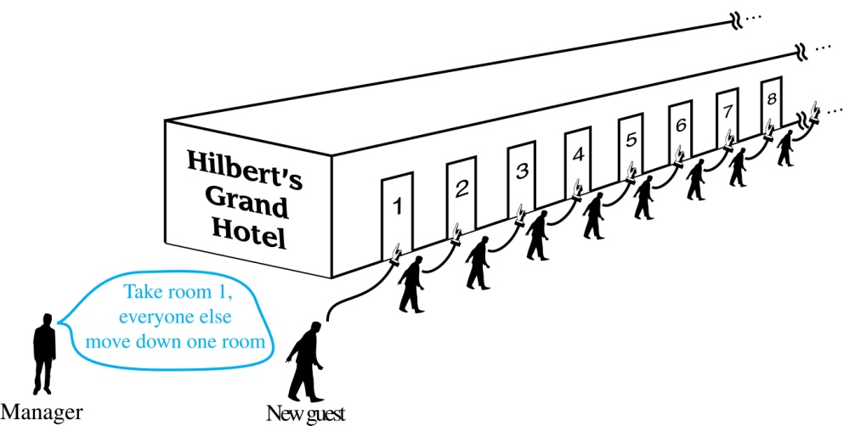
Hilbert’s Grand Hotel
David Hilbert
The Grand Hotel (example due to David Hilbert) has countably infinite number of rooms, each occupied by a guest. We can always accommodate a new guest at this hotel. How is this possible?
Explanation: Because the rooms of Grand Hotel are countable, we can list them as Room 1, Room 2, Room 3, and so on. When a new guest arrives, we move the guest in Room 1 to Room 2, the guest in Room 2 to Room 3, and in general the guest in Room n to Room n + 1, for all positive integers n. This frees up Room 1, which we assign to the new guest, and all the current guests still have rooms.
The hotel can also accommodate a countable number of new guests, all the guests on a countable number of buses where each bus contains a countable number of guests (see exercises).

Slide 14
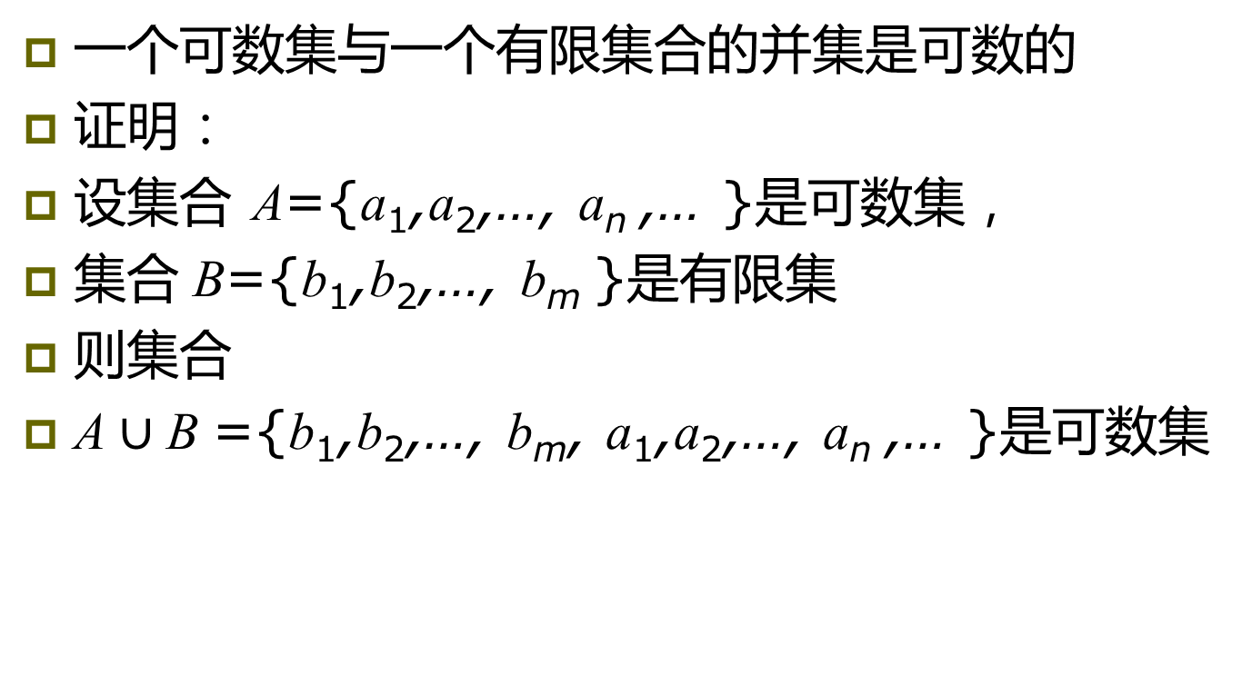
Hilbert’s Grand Hotel（一般形式）
一个可数集与一个有限集合的并集是可数的
证明：
设集合 A={a₁,a₂,…, a_{n} ,… }是可数集，
集合 B={b₁,b₂,…, b_{m} }是有限集
则集合
A $∪$B ={b₁,b₂,…, b_{m}, a₁,a₂,…, a_{n} ,… }是可数集

Slide 15
The Positive Rational Numbers are Countable
Definition: A rational number can be expressed as the ratio of two integers p and q such that q ≠ 0.
¾ is a rational number
√2 is not a rational number.
Example 3: Show that the positive rational numbers are countable.
Solution:The positive rational numbers are countable since they can be arranged in a sequence:
r₁ , r₂ , r₃ ,…
The next slide shows how this is done. →

Slide 16
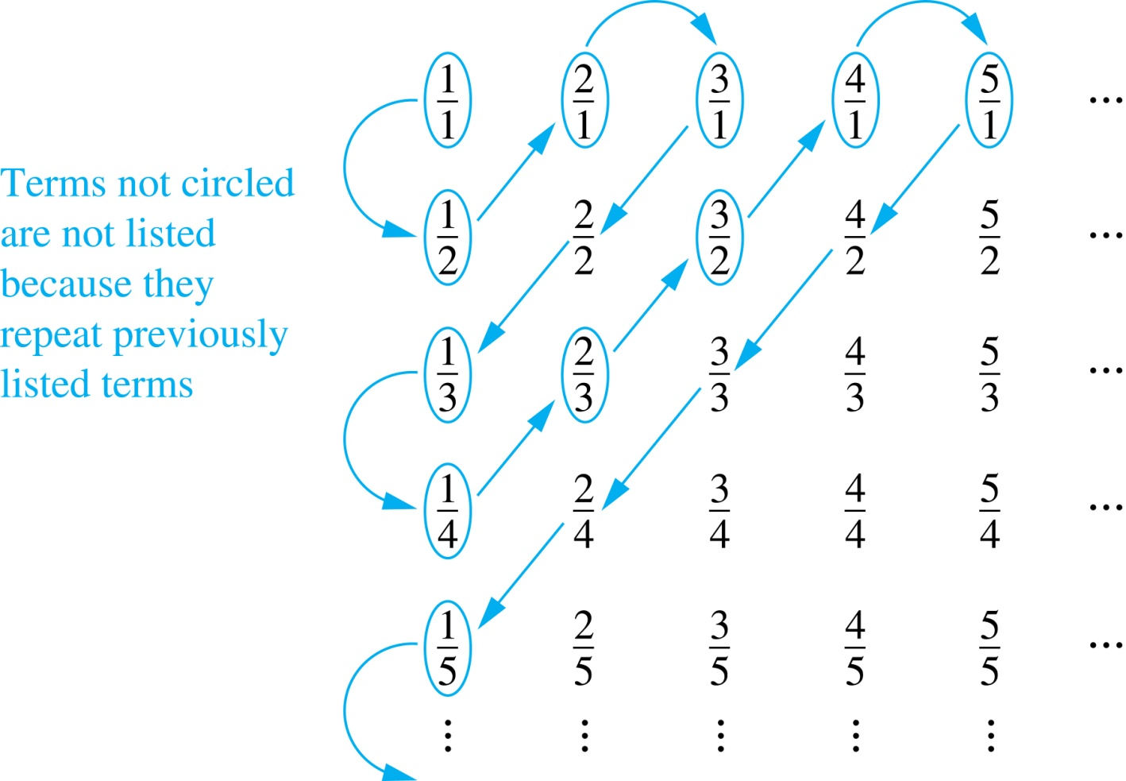
The Positive Rational Numbers are Countable
First row q = 1.
Second row q = 2.
etc.
Constructing the List
First list p/q with p + q = 2.
Next list p/q with p + q = 3
And so on.
1, ½, 2, 3, 1/3,1/4, 2/3, ….

Slide 17
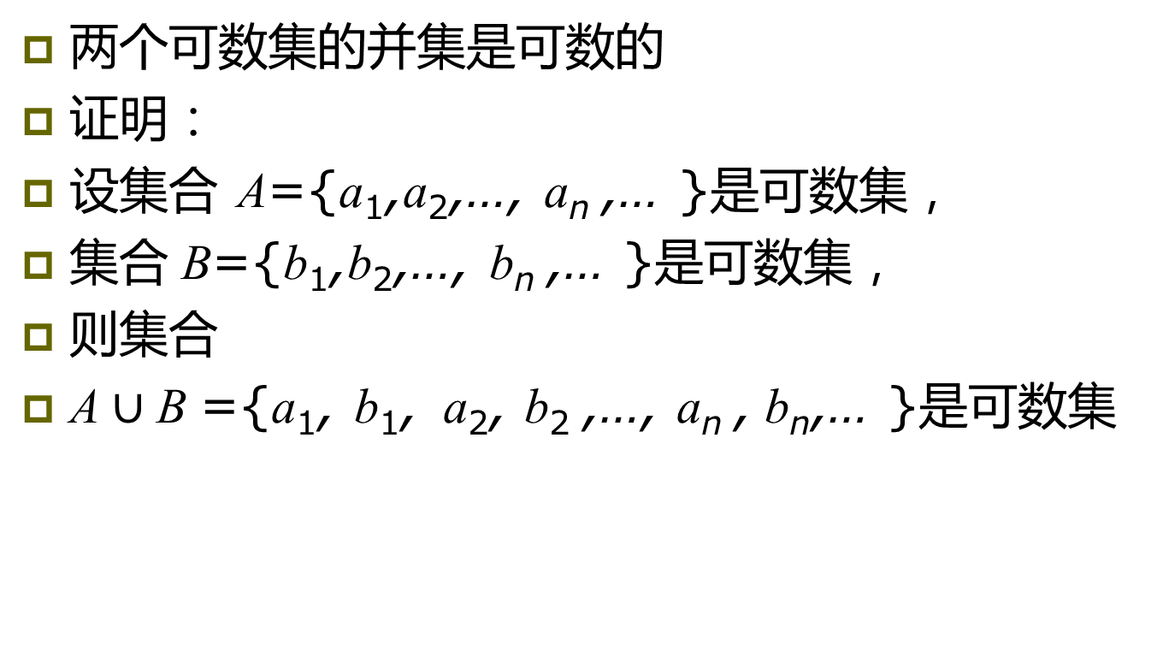
关于可数集的结论
两个可数集的并集是可数的
证明：
设集合 A={a₁,a₂,…, a_{n} ,… }是可数集，
集合 B={b₁,b₂,…, b_{n} ,… }是可数集，
则集合
A $∪$B ={a₁, b₁, a₂, b₂ ,…, a_{n} , b_{n},… }是可数集

Slide 18
Strings
Example 4: Show that the set of finite strings S over a finite alphabet A is countably infinite.
Assume an alphabetical ordering of symbols in A
Solution: Show that the strings can be listed in a sequence. First list
All the strings of length 0 in alphabetical order.
Then all the strings of length 1 in lexicographic (as in a dictionary) order.
Then all the strings of length 2 in lexicographic order.
And so on.
This implies a bijection from N to S and hence it is a countably infinite set.

Slide 19
The set of all Java programs is countable
Example 5: Show that the set of all Java programs is countable.
Solution: Let S be the set of strings constructed from the characters which can appear in a Java program. Use the ordering from the previous example. Take each string in turn:
Feed the string into a Java compiler. (A Java compiler will determine if the input program is a syntactically correct Java program.)
If the compiler says YES, this is a syntactically correct Java program, we add the program to the list.
We move on to the next string.
In this way we construct an implied bijection from N to the set of Java programs. Hence, the set of Java programs is countable.

Slide 20
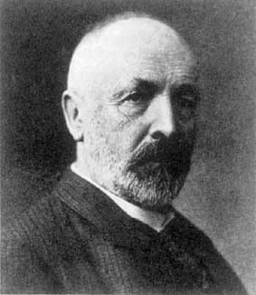
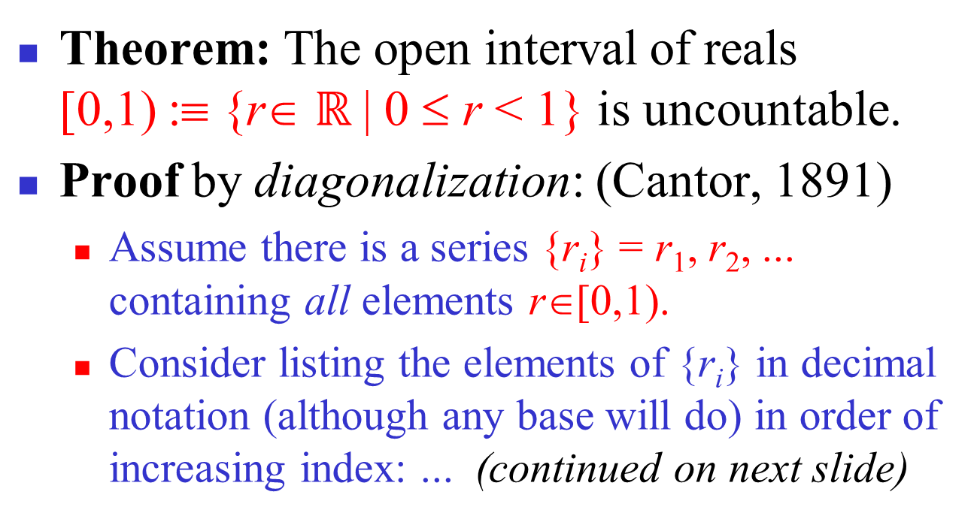
Uncountable Sets: Example
Georg Cantor
1845-1918

Slide 21
Uncountability of Reals, cont’d
A postulated enumeration of the reals: r₁ = 0.d_{1,1} d_{1,2} d_{1,3} d_{1,4} d_{1,5} d_{1,6} d_{1,7} d_{1,8}… r₂ = 0.d_{2,1} d_{2,2} d_{2,3} d_{2,4} d_{2,5} d_{2,6} d_{2,7} d_{2,8}… r₃ = 0.d_{3,1} d_{3,2} d_{3,3} d_{3,4} d_{3,5} d_{3,6} d_{3,7} d_{3,8}… r₄ = 0.d_{4,1} d_{4,2} d_{4,3} d_{4,4} d_{4,5} d_{4,6} d_{4,7} d_{4,8}… . . .
Now, consider a real number generated by taking all the digits d_{i,i} that lie along the diagonal in this figure and replacing them with different digits.
That real doesn't appear in the list!
Notes:
Why? Because it’s first digit is different from the first digit of r1, its second digit is different from the second digit of r2, and in general its nth digit is different from the nth digit of rn. Therefore it is different from every number in the list. We may want to restrict ourselves to change the digit to one other than 9 because if we change it to a nine, the resulting number could be say .1239999999999… infinitely which is equal to .1240000000000… (which could be in the list) even though the digits don’t match. But, actually this imagined problem doesn’t actually arise because since there are an infinite number of reals that don’t include any 9’s, it is impossible for the diagonal to be all 9’s beyond some finite point.

Slide 22
Uncountability of Reals, fin.
E.g., a postulated enumeration of the reals: r₁ = 0.301948571… r₂ = 0.103918481… r₃ = 0.039194193… r₄ = 0.918237461…
OK, now let’s add 1 to each of the diagonal digits (mod 10), that is changing 9’s to 0.
0.4103… can’t be on the list anywhere!

Slide 23
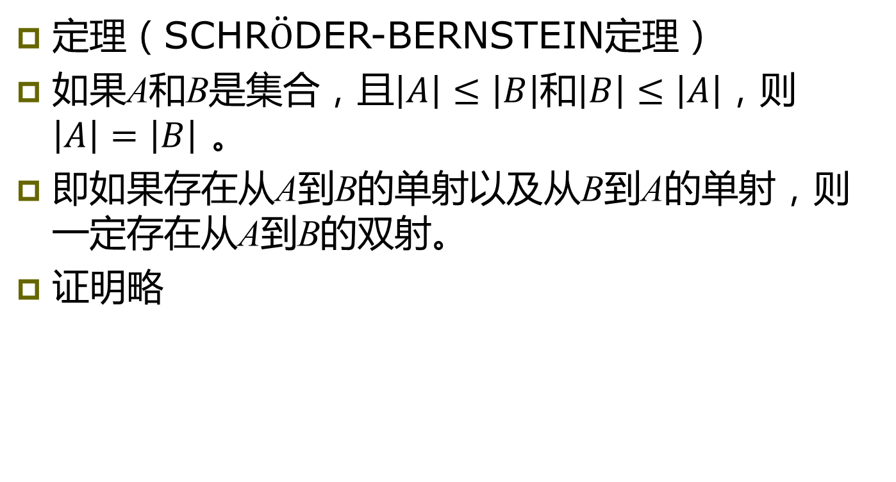
基数中的关键定理
定理（SCHR$\ddot{O}$DER-BERNSTEIN定理）
如果A和B是集合，且$\left|A\right|≤\left|B\right|$和$\left|B\right|≤\left|A\right|$，则$\left|A\right|=\left|B\right|$ 。
即如果存在从A到B的单射以及从B到A的单射，则一定存在从A到B的双射。
证明略

Slide 24
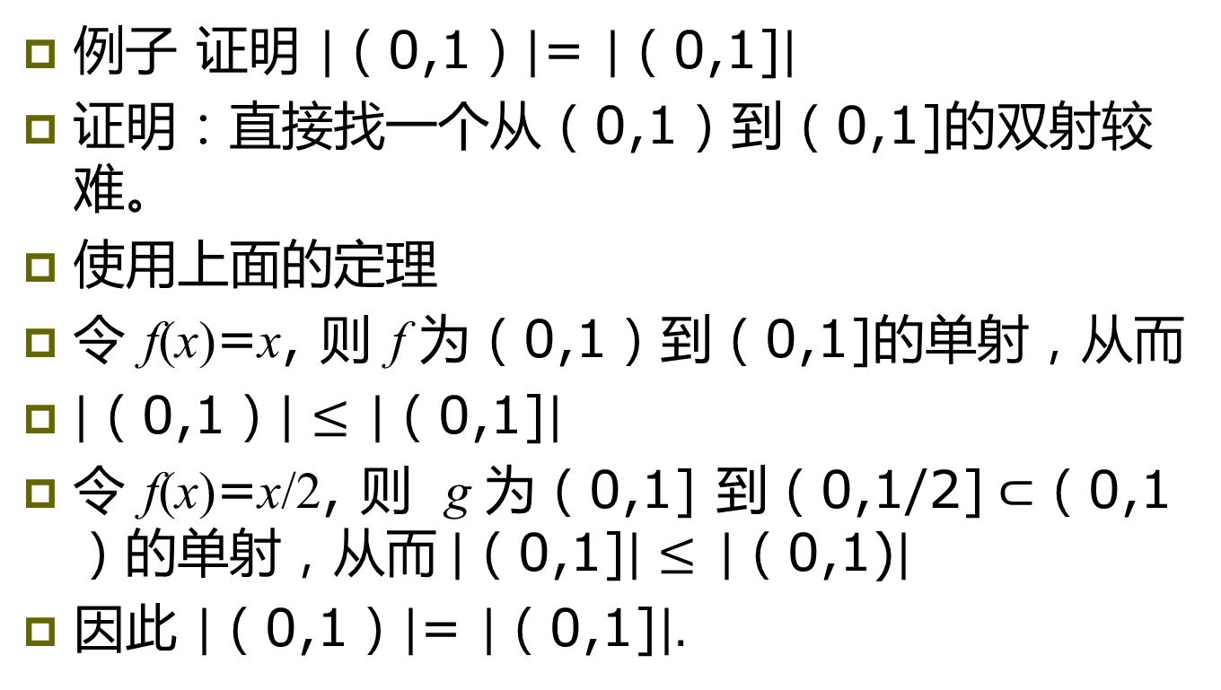
基数中关键定理的应用
例子 证明 $\left|\text{（}\text{0,1}\text{）}\right|$= $\left|\text{（}\text{0,1]}\right|$
证明：直接找一个从（0,1）到（0,1]的双射较难。
使用上面的定理
令 f(x)=x, 则 f 为（0,1）到（0,1]的单射，从而
$\left|\text{（}\text{0,1}\text{）}\right|≤$ $\left|\text{（}\text{0,1]}\right|$
令 f(x)=x/2, 则 g 为（0,1] 到（0,1/2]$⊂$（0,1）的单射，从而$\left|\text{（}\text{0,1}\text{]}\right|≤$ $\left|\text{（}\text{0,1}\text{)}\right|$
因此 $\left|\text{（}\text{0,1}\text{）}\right|$= $\left|\text{（}\text{0,1]}\right|.$

Slide 25
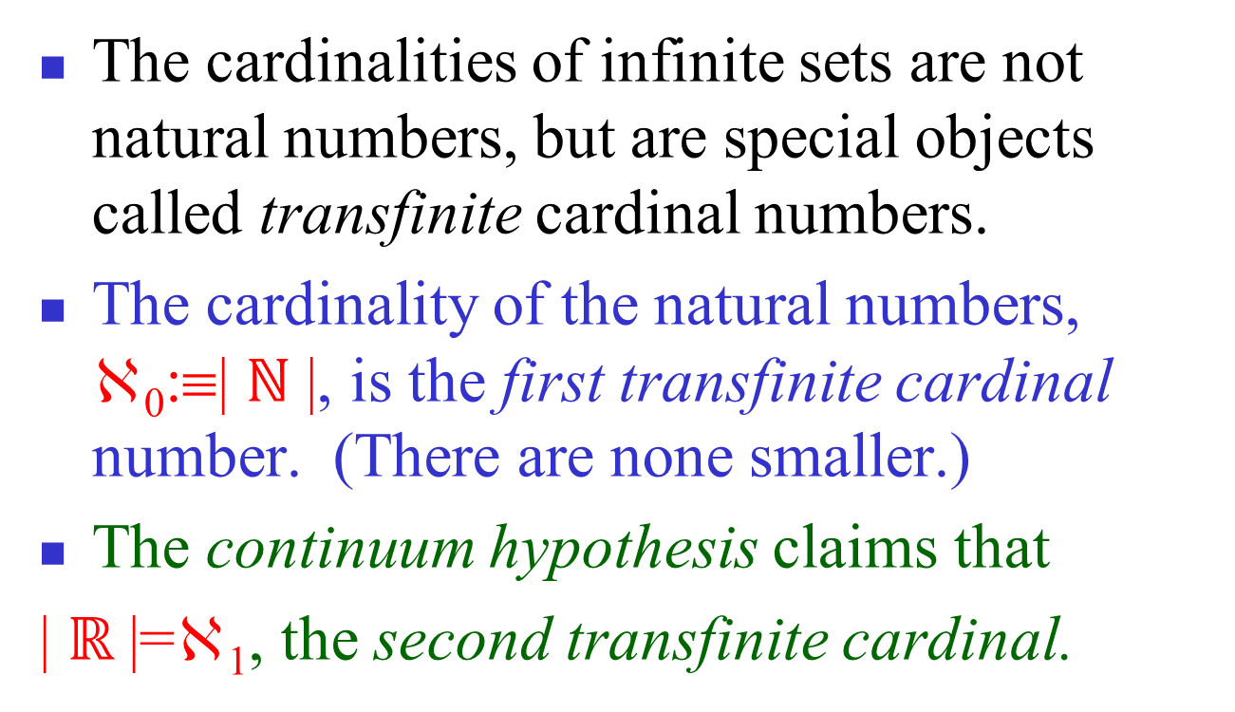
Transfinite Numbers
Proven impossible to prove or disprove!
Notes:
In other words, the continuum hypothesis has been shown to be independent from the other axioms of set theory that led to the definition of transfinite cardinals.

Slide 26
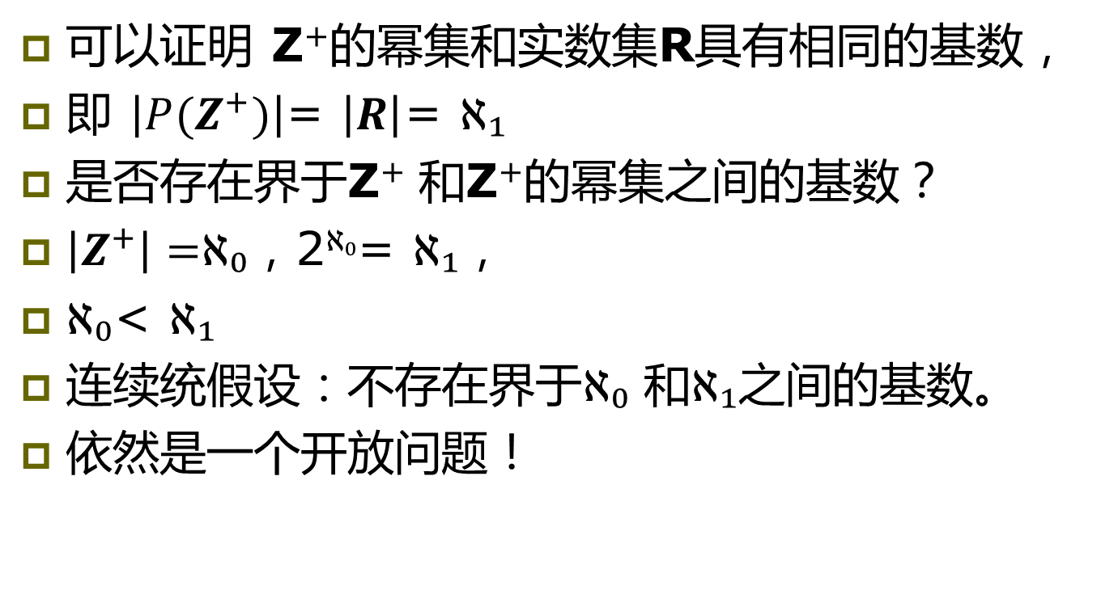
连续统假设
可以证明 Z⁺的幂集和实数集R具有相同的基数，
即 $\left|P(Z^{+})\right|$= $\left|R\right|$= ℵ₁
是否存在界于Z⁺ 和Z⁺的幂集之间的基数？
$\left|Z^{+}\right|=$ℵ₀，2^{ℵ₀}= ℵ₁，
ℵ₀< ℵ₁
连续统假设：不存在界于ℵ₀ 和ℵ₁之间的基数。
依然是一个开放问题！

Slide 27
Countable vs. Uncountable
You should:
Know how to define “same cardinality” in the case of infinite sets.
Know the definitions of countable and uncountable.
Know how to prove (at least in easy cases) that sets are either countable or uncountable.

Slide 28
Computability (Optional)
Definition: We say that a function is computable if there is a computer program in some programming language that finds the values of this function. If a function is not computable we say it is uncomputable.
There are uncomputable functions. We have shown that the set of Java programs is countable. Exercise 38 in the text shows that there are uncountably many different functions from a particular countably infinite set (i.e., the positive integers) to itself. Therefore (Exercise 39) there must be uncomputable functions.

Slide 29
Homework
§2.5
2, 10

